Slide 1
PERFORMANCE APPRAISAL
PRESENTERS
Pragya Gyawali
Ismita Jha

Slide 2
“”A little Appreciation never hurt anyone.””

Slide 3

“To do any work and get appreciation for it.” Expert says,” Performance Appraisal is the systematic description of job relevant strengths and weaknesses of an individual or group.” PA prerequisites: Define Performance. Facilitate Performance. Encourage Performance

Slide 4


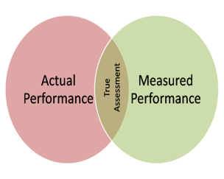

Process of Performance Appraisal
Establishing Performance Standards
1
Communicating Standards and Exceptions
2
Measuring the actual performance
3
Comparing with Standards
4

Slide 5


Process of Performance Appraisal
Discussing results (providing feedback)
5
Decision making- taking corrective actions
6

Slide 6
Methods of Performance Appraisal

Slide 7
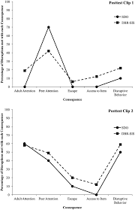
Graphic Rating Scale
Employees rated on personality characteristic & performance
Permits statistical tabulation of scores
Rating is generally subjective
Assumes each characteristic is equally imp for all job

Slide 8
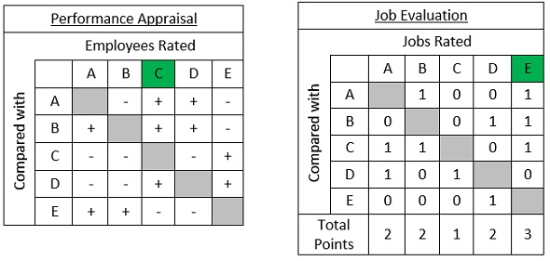
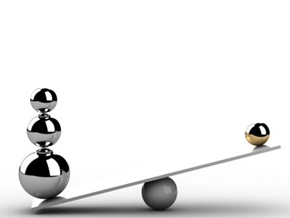
Paired Comparison
Way of obtaining rank-order listing employees
Requires comparison of each employee with every other
Helps to know overall performance of the employees
Does not consider specific component of behavior

Slide 9
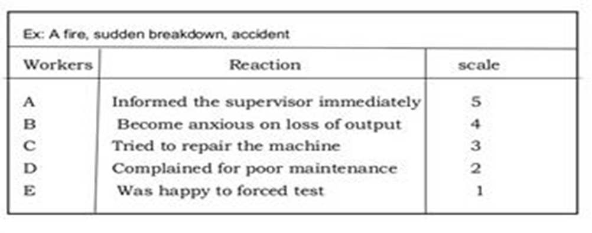

Critical Incident Method
Actions taken during the incident
Used to improve multi user systems
Relies on the incidents being remembered by raters
Supervisors may be biased

Slide 10
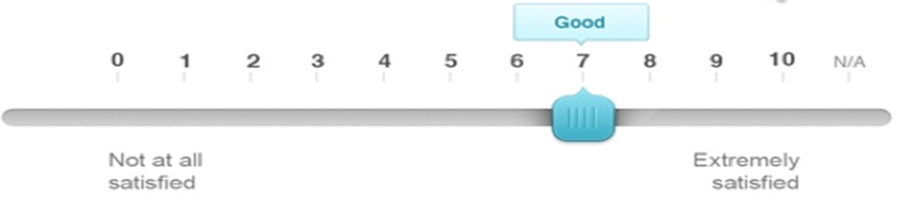
Behaviorally Anchored Rating Scales
Separate rating form must be developed for each job
Avoids problems like biasness
Requires considerable time and effort
Method is new and costly

Slide 11

Management by Objectives (MBO)
Joint goal setting
Action planning
Self-control
Periodic progress reviews

Slide 12

Any Queries??

